Slide 1
Discovering the Most In-Demand Skills for Data Science and Analytics
By: Anel Coralic

Slide 2

Outline
Introduction
Data Collection
Data Cleaning
Data Analysis
Conclusion
References

Slide 3
Introduction
Welcome to my DSA skills project. I conducted research on the most in-demand skills and job titles in this field to help Georgia Gwinnett College students better understand the job market. In this presentation, I will take you through my process, from data collection to analysis, and share my findings. Additionally, I added my data to an existing website called Grizzly Paths that maps the necessary skills to courses offered at the college. Let's begin by discussing the data collection process.

Slide 4
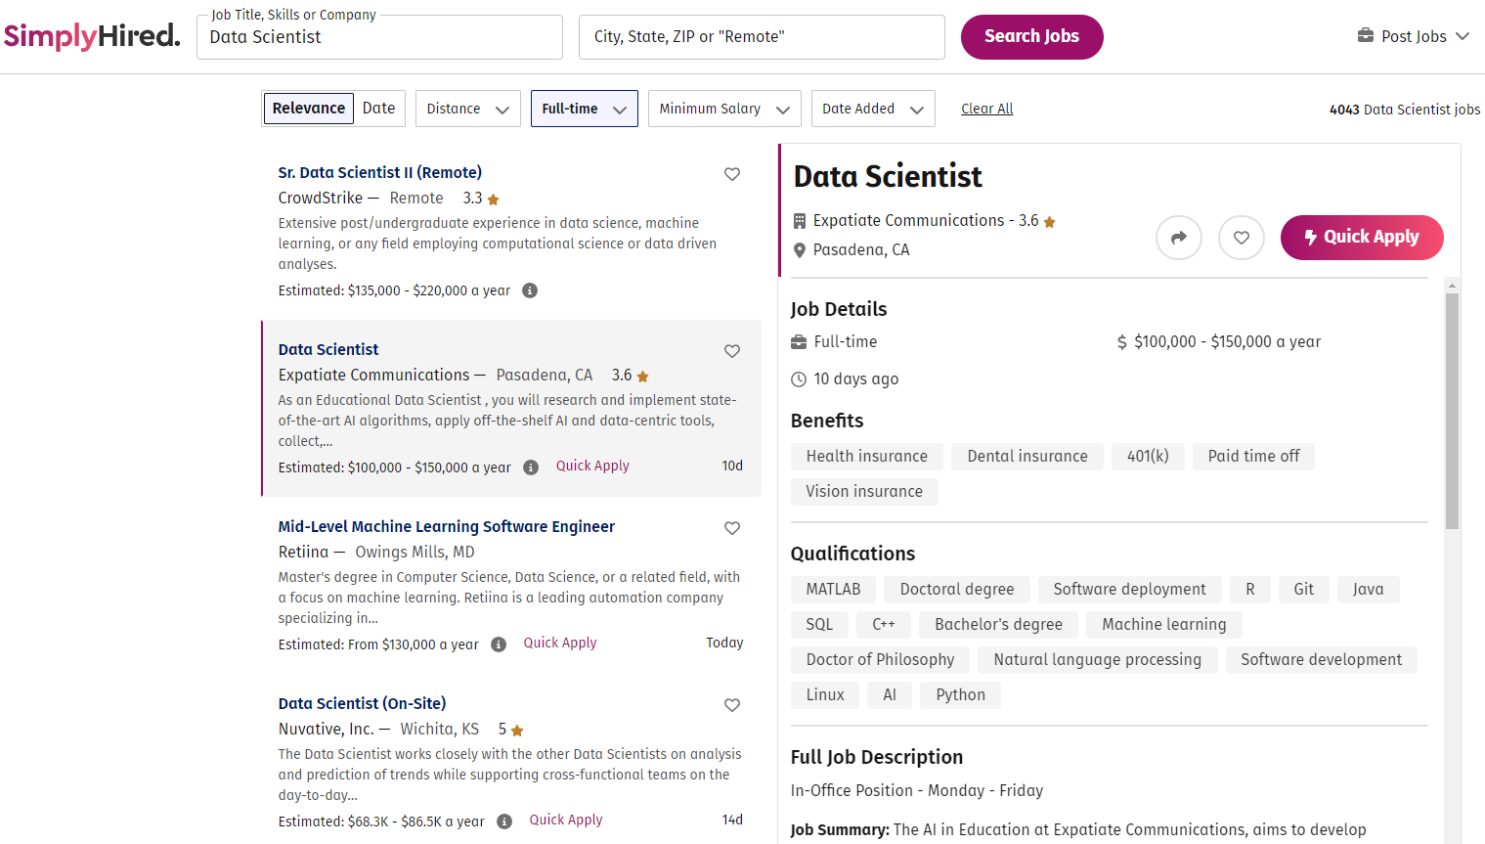
Data Collection
I used Data Scientist as a key word to search SimplyHired.com for full time jobs.

Slide 5
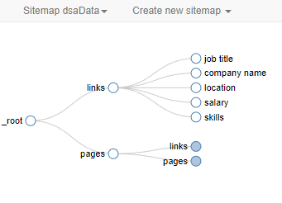
Web Scraper
To begin extracting the data from the website, I used a free google chrome extension called Web Scraper. This tool allowed me to scrape the job postings for the job title, company name, location, salary, and skills. I created a new Sitemap, entered the start URL, and set up the selectors to define how the site will be navigated and extracted. I launched the Sitemap, waited for the data to be scraped, and downloaded the data into an excel file.

Slide 6
Data Cleaning
To prepare the collected data for analysis, several data cleaning procedures had to be carried out.
The job titles were too specific.
The location needs to be split into city and state columns.
There are strings and characters in the salaries.
The salaries are ranges.
The skills have job benefits and educational degrees included.
The skills are put on a new record for each skill and the jobs are duplicated.

Slide 7
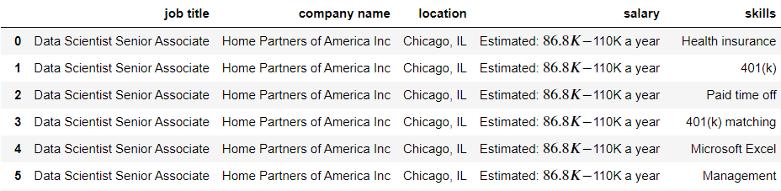
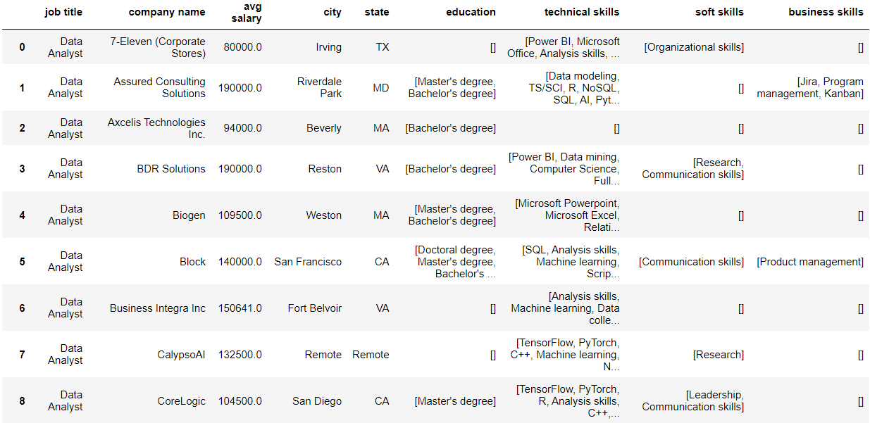
The job titles were simplified into the three most common job titles: Data Scientist, Data Analyst, and Data Architect.
An average salary was created from the ranges and made numerical.
City and state were separated.
The educational degrees were taken out from the skills.
The skills were separated into technical, soft, and business skills.
The skills were collapsed into lists and grouped by their job.

Slide 8

Data Analysis
After collecting the data and cleaning it, I did analysis to identify the most in-demand skills and job titles in this field. In the next slides, I will share my findings. By the end of this section, you will have a clear understanding of the skills and job titles that are most in demand in the data science and analytics job market.

Slide 9
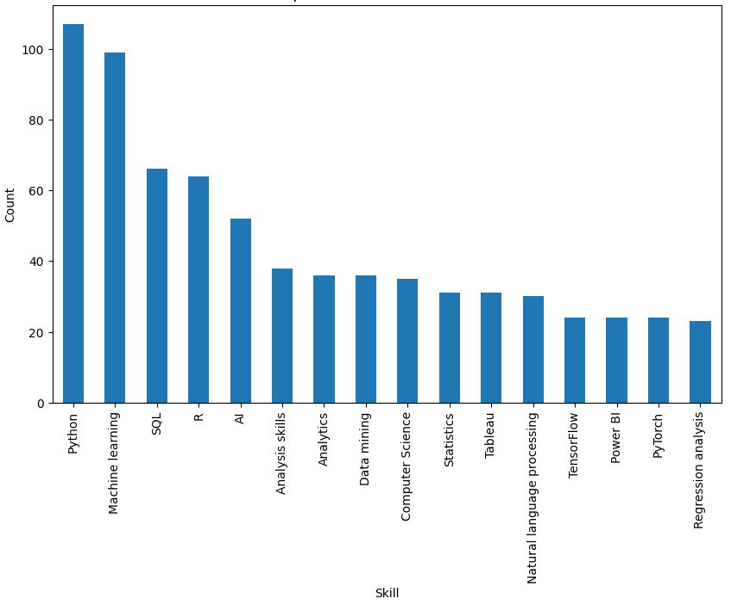
Top 16 DSA Technical Skills
Python, Machine Learning, SQL, and R are the most common and essential skills for professionals in the DSA field. AI, Analysis Skills, Analytics, and Data Mining are also highly valued skills. Computer Science, Statistics, and data visualization tools like Tableau, Power BI, and TensorFlow are also great skills to possess. The results suggest that a strong foundation in programming languages, machine learning, and data analysis is essential.

Slide 10
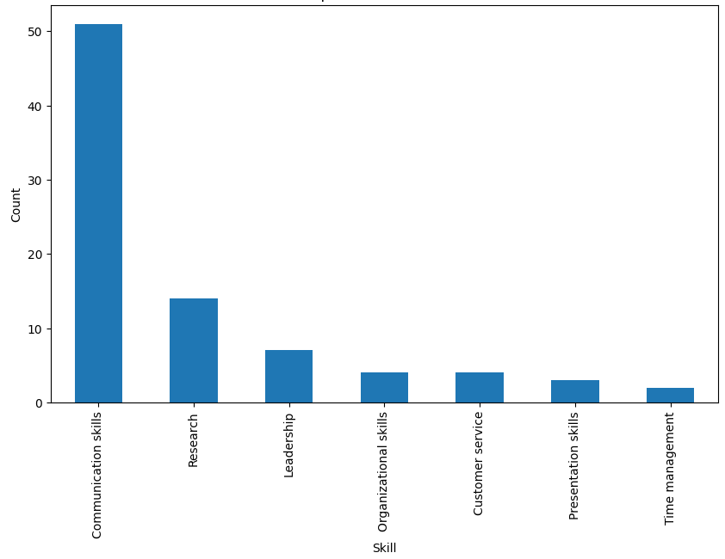
Top DSA Soft Skills
The job market highly values soft skills such as communication above all else. Employers are looking for candidates who possess a strong ability to effectively communicate with others.
Research, leadership, and presentation skills are also good soft skills to have. Job seekers who can demonstrate proficiency in these soft skills may have a competitive edge in the job market for data science and analytics positions.

Slide 11
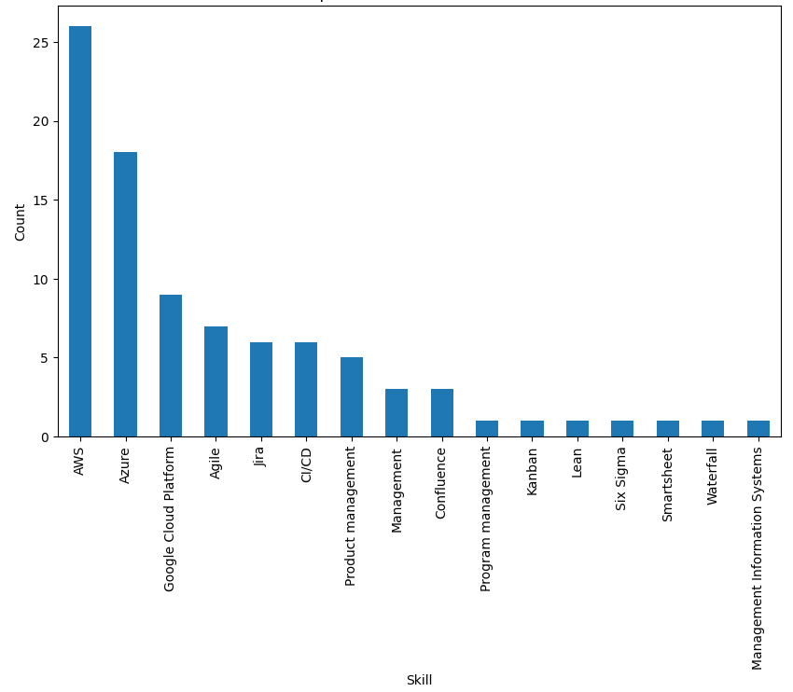
Top 16 DSA Business Skills
There is a high demand for professionals who possess expertise in cloud computing platforms, specifically AWS, Azure, and Google Cloud Platform.
Proficiency in project management methodologies such as Waterfall, Agile, Jira, CI/CD, Product Management, and Confluence are highly valued by employers.

Slide 12
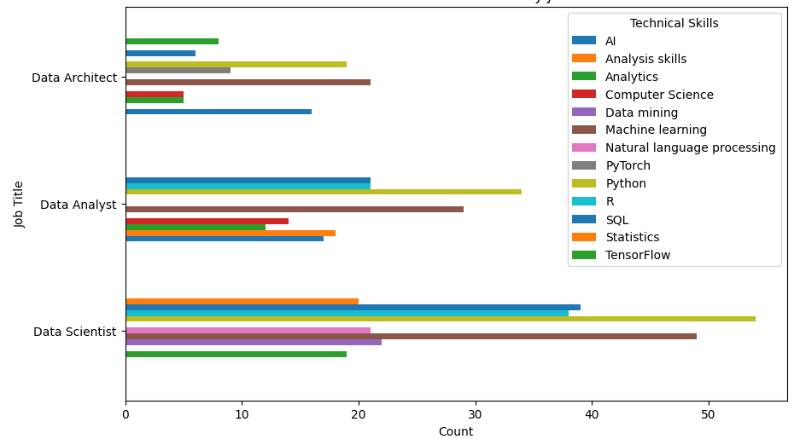
Most Common Technical Skills by Job Title
The three job titles share many skills including Python, Analysis Skills/Analytics, and Machine Learning. Data Scientists and Data Analysts share most of their skills. According to the data, you are more likely to use Statistics and SQL as a Data Analyst. You are more likely to use Data Mining, Natural language processing, and TensorFlow as a Data Scientist. A Data Architect is more AI focused requiring AI, PyTorch, and TensorFlow skills.

Slide 13
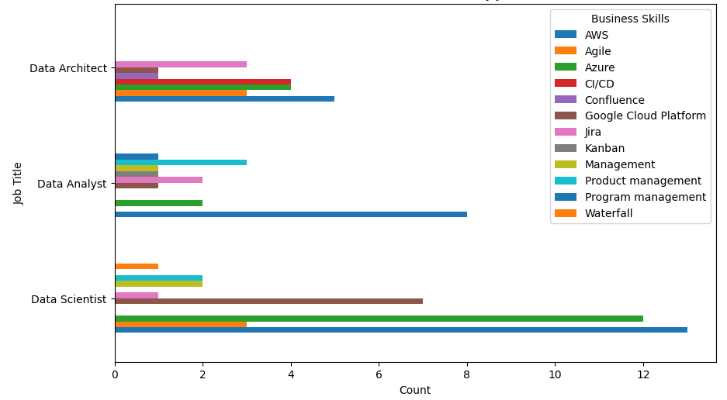
Most Common Business Skills by Job Title
The three job titles share many of the cloud computing platform skills as well as the project management methodologies such as Waterfall, Agile, Jira. Data Scientists and Data Analysts are very similar again. A Data Architect is unique in that Product Management is not in its top required skills, but Confluence and CI/CD is.

Slide 14

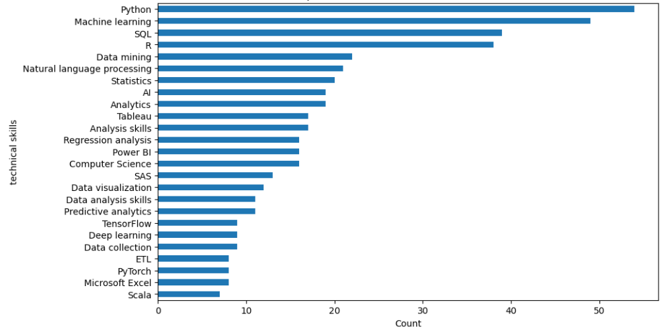
Top 25 Technical Skills for a Data Scientist

Slide 15
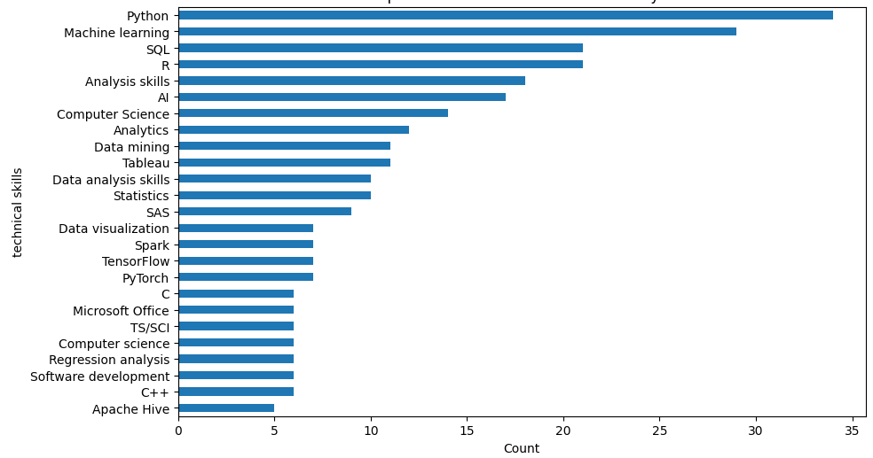
Top 25 Technical Skills for a Data Analyst

Slide 16
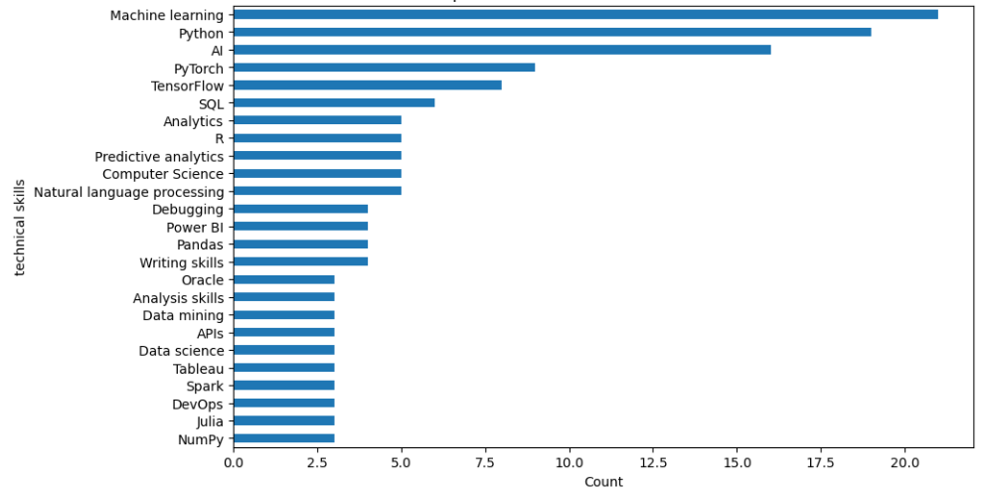
Top 25 Technical Skills for a Data Architect

Slide 17
Conclusion
In conclusion, this project gathered insights into the data science and analytics job market. The findings are useful for students and professionals interested in pursuing a career in data science and analytics. Furthermore, the addition of this data to an existing website will be beneficial to students at GGC, as it will help them select the appropriate courses needed to pursue a career.
Website (Grizzly Paths):
https://ggc-dsa.github.io/itskills/

Slide 18
References
Github: https://github.com/GGC-DSA/itskills/tree/main/Anel's%20DSA
Website (Grizzly Paths): https://ggc-dsa.github.io/itskills/
Web Scraper Extension: https://chrome.google.com/webstore/detail/web-scraper-free-web-scra/jnhgnonknehpejjnehehllkliplmbmhn?hl=en
Microsoft Excel, Python, Jupyter Notebook, Github Desktop, Atom, Visual Studio Code

